Slide 1
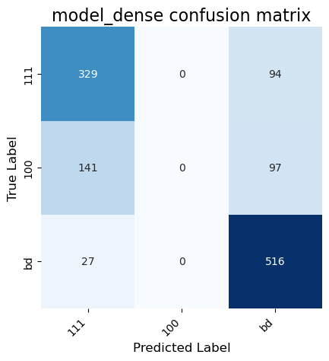
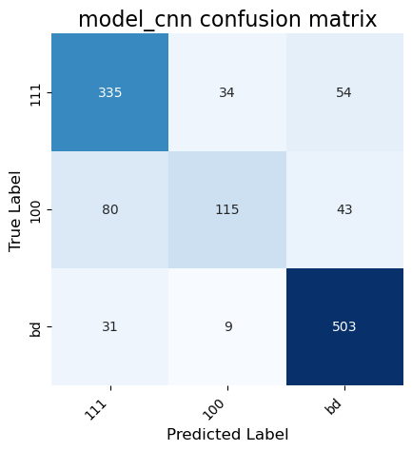
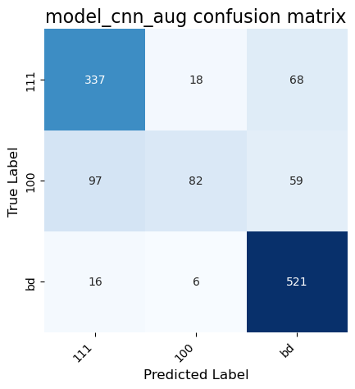
Assessment Figures

Slide 2
ML4ER Assignment 7
Jiahui Yang
Informatics Skunkworks
MSE 401, 3 Credits
Aug 07 2024

Slide 3
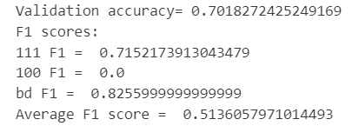
Progress
Your confusion matrix and F1 scores for Section 1 with the default Fully Connected Network (FCN)
The model has a validation accuracy of 70.18%, with high F1 scores for classes "111" (0.715) and "bd" (0.826), but the model fails to correctly predict any instances of class "100" (F1 score of 0). The average F1 score is 0.514.

Slide 4
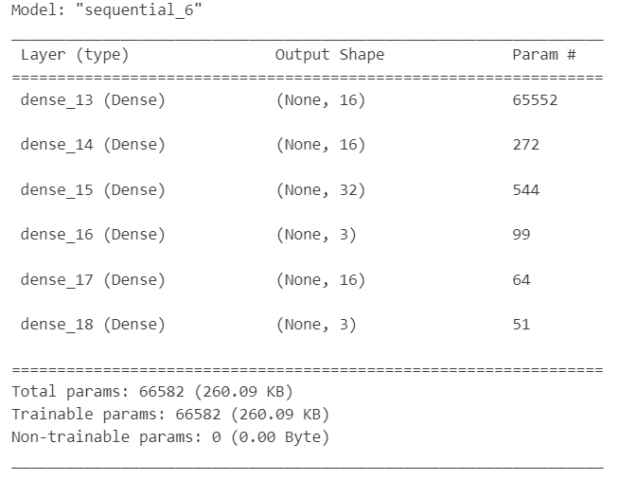
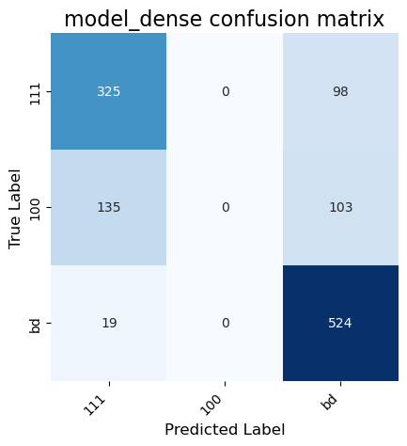
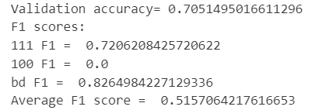
Progress
The model has a validation accuracy of 70.51%, with high F1 scores for classes "111" (0.721), "bd" (0.826), and "100" (0.0). The average F1 score is 0.516.
Your confusion matrix and F1 scores for exercise 1 - adding layers to your FCN

Slide 5
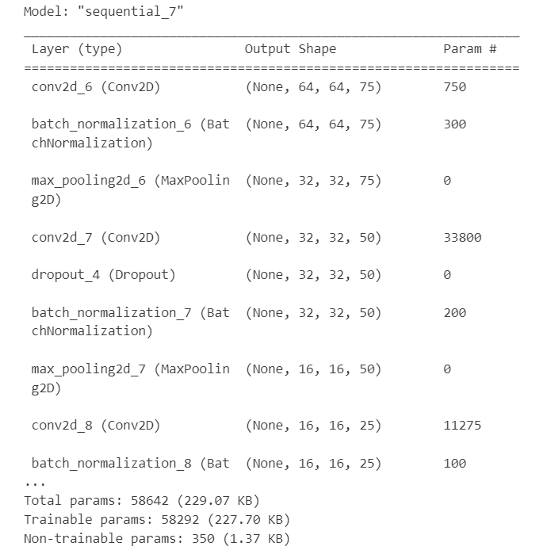
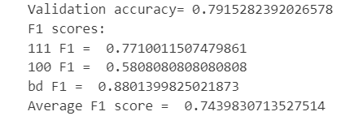
Progress
The model has a validation accuracy of 79.15%, with high F1 scores for classes "111" (0.771), "bd" (0.880), and "100" (0.581). The average F1 score is 0.744.
Your confusion matrix and F1 scores for exercise 2 - modifying convolution layers

Slide 6
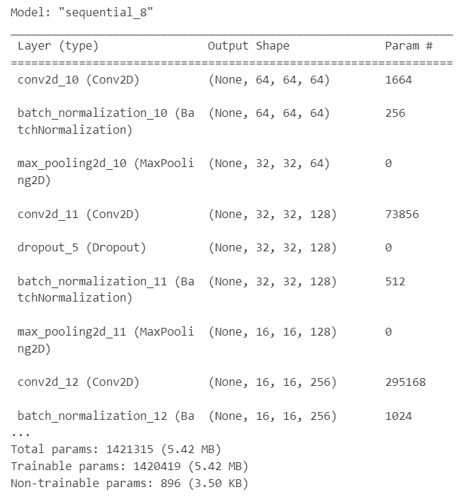

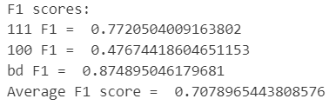
Progress
The model has a validation accuracy of 78.01%, with high F1 scores for classes "111" (0.772), "bd" (0.875), and "100" (0.477). The average F1 score is 0.708.
Your confusion matrix and F1 scores for exercise 3 - modifying convolution layers

Slide 7
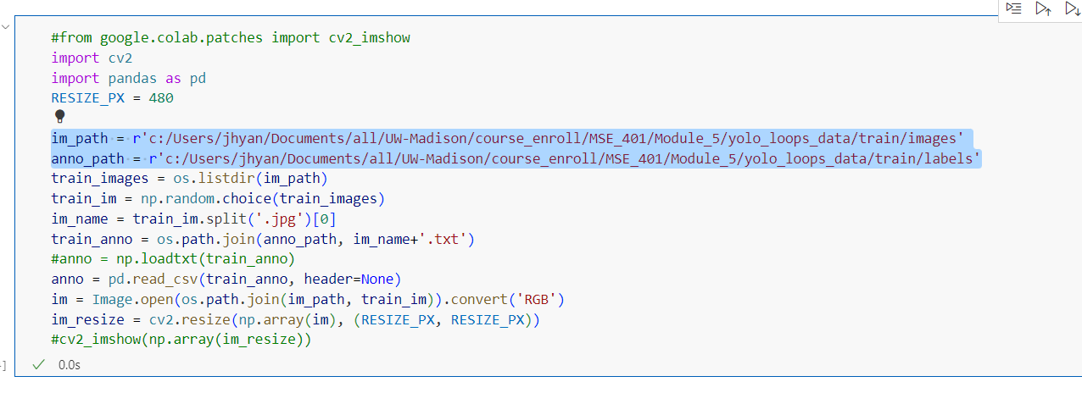
Problems
I was running the Jupyter notebook on my local machine and had to manually change several paths. Below is a screenshot as an example.

Slide 8
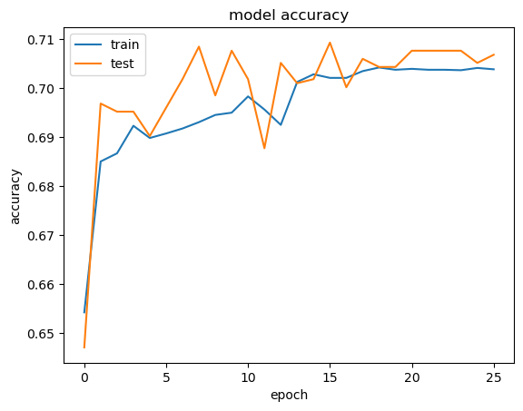
Questions
How to further enhance model performance and improve its accuracy?

Slide 9
Hours Summary
Date | Hours | Description of Work
08/05/2024 | 3 hours | Work Through the "ML4M - Image Data Activities.ipynb" notebook and follow along with the recording

